Slide 1
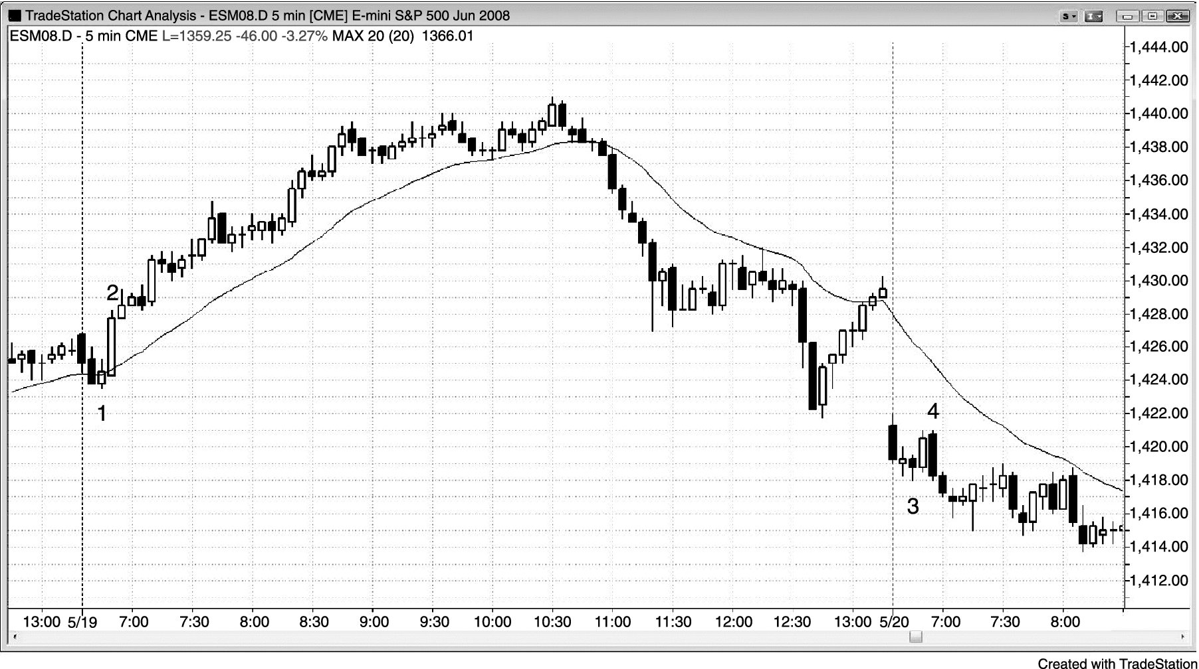
FIGURE PIII.1 Failed Early Reversal

Slide 2
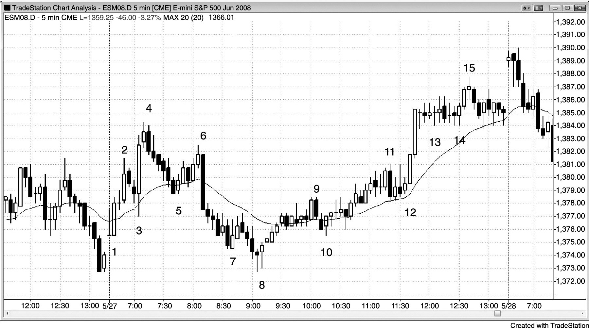
FIGURE PIII.2 The First Few Bars Can Set the Tone

Slide 3
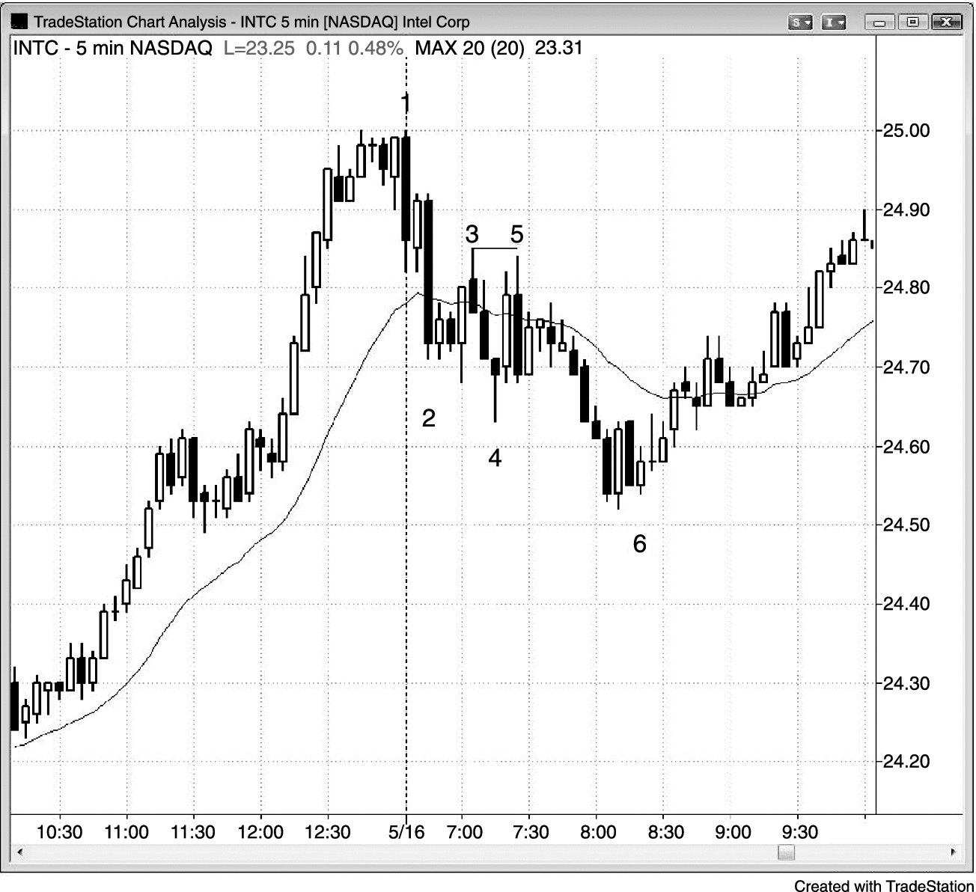
FIGURE PIII.3 Don’t Scalp Stocks with Small Ranges

Slide 4
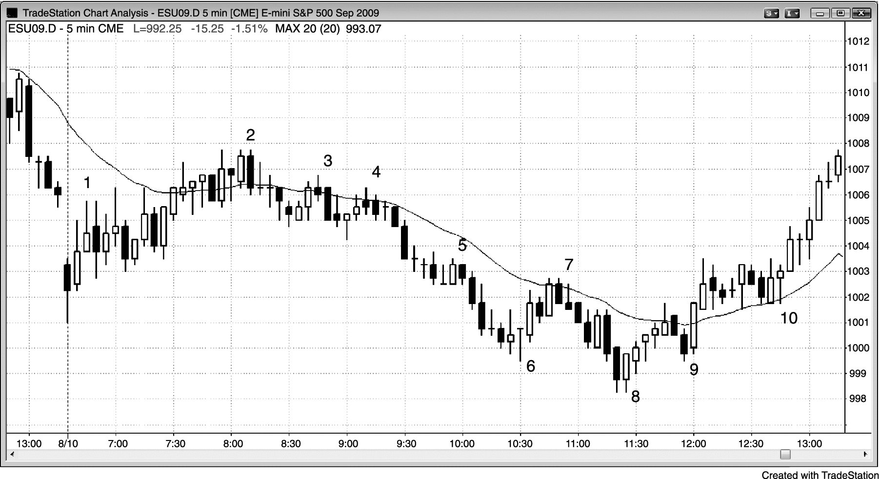
FIGURE PIII.4 Early Barbwire Often Leads to a Trading Range Day

